Slide 1

ALGHERO RACE HISTORY
Elite Analysis · Past 8 Years · April 2026
USA Triathlon High Performance

Slide 2
Key Course Differentiators
Alghero
ALGHERO
COURSE AT A GLANCE
[PLACEHOLDER: 2-3 sentences on what makes Alghero unique as a race venue — geography, setting, and character. E.g. 'Set on the Coral Riviera of Sardinia, the WTCS Alghero course combines crystal-clear Mediterranean waters, a flat coastal bike circuit, and a multi-lap run through the ancient walled city.']
Swim:
1.5 km
Bike:
40.5 km
Run:
10.0 km
Format:
Standard Triathlon
COURSE FEATURES
Bike Laps:
9
Run Laps:
4
• [PLACEHOLDER: Feature 1 — e.g. 'Open-water swim in the Bay of Alghero — calm seas']
QUICK LINKS
• [PLACEHOLDER: Feature 2 — e.g. 'Flat coastal bike circuit — fast and tactical']
Current Race Info:
[PLACEHOLDER: https://www.triathlon.org/events/event/2026_world_triathlon_championship_series_alghero]
• [PLACEHOLDER: Feature 3 — e.g. 'Multi-lap run through the historic city centre']
Last Year's Results:
https://www.triathlon.org/events/event/2025_world_triathlon_championship_series_alghero
• [PLACEHOLDER: Feature 4 — e.g. 'Hot Mediterranean conditions typical in late May']
Race Replay:
[PLACEHOLDER: https://triathlonlive.tv/ (TriathlonLIVE replay)]

Slide 3
Course Profile & Map
Alghero
[PLACEHOLDER: Insert upcoming course map or race photo here] Right-click → Replace Image, or paste screenshot of the World Triathlon course map PDF.
[PLACEHOLDER: Insert previous year course map or race photo here] Right-click → Replace Image, or paste screenshot of the World Triathlon course map PDF.
2026 Course
2025 Course
Source: [PLACEHOLDER: World Triathlon event page URL]
Source: https://www.triathlon.org/events/event/2025_world_triathlon_championship_series_alghero
Discipline | Distance | Laps | Terrain / Notes
Swim | 1.5 km | — | [PLACEHOLDER: e.g. Open-water, Bay of Alghero]
Bike | 40.5 km | 9 | [PLACEHOLDER: e.g. Flat coastal road circuit, closed course]
Run | 10.0 km | 4 | [PLACEHOLDER: e.g. Flat multi-lap, cobblestone city-centre finish]

Slide 4
Environmental Risk Profile
Alghero
RACE-DAY WEATHER (08:00–11:00 local)
AIR QUALITY (Open-Meteo archive)
Year | Date | Air Temp | Humidity | Wind km/h | Precip mm
2025 | May 31 | 27 | 72% | 9 | 0.0
Year | PM2.5 | EU AQI | UV Index | Risk
2025 | 6.0 | 30 | 3.4 | Fair
HEALTH & WATER QUALITY RISK FACTORS
• Water Quality: [PLACEHOLDER: Historical water quality data for Alghero — e.g. bacterial counts, EU Bathing Water Directive status, known algae / pollution events. Check local environmental agency reports for May race window.]
• Athlete Health Incidents: [PLACEHOLDER: Any known GI illness, respiratory, or heat-related incidents at this or comparable venues. E.g. Sunderland 2023 — reported GI illness post-swim for multiple athletes.]
• Water Temperature: [PLACEHOLDER: Historical open-water temperature for Alghero in May (not available from Open-Meteo; check Copernicus Marine / NOAA or WT historical results).]
• Heat / Humidity Risk: Auto-derived from above table — flag if humidity >70% or air temp >25°C at race time.
Weather and AQ data: Open-Meteo historical archive (archive-api.open-meteo.com). EU AQI: Good ≤20, Fair ≤40, Moderate ≤60, Poor ≤80, Very Poor >80.

Slide 5
ELITE MEN

Slide 6
Race Overview — Elite Men
Alghero
RACE HISTORY AT ALGHERO
3 KEYS TO SUCCESS
The Elite Men race at Alghero has been held 1 time in this analysis window (2025–2025). The event is staged as part of the World Championship Series calendar. [PLACEHOLDER: Add 1–2 sentences on notable storylines, competitive history, or what makes this event significant for Elite Men athletes. E.g. defending champions, record performances, dramatic finishes.]
1
Swim positioning matters — an average of 16 athletes exit the water within 15 sec of the leader. Entering the bike in the front pack is critical; conserve energy with a disciplined swim line rather than sprinting alone.
2
[PLACEHOLDER: Key 2 — Describe bike strategy: is this a pack race or do breakaways form? What power/tactics are needed to stay in the lead group?]
3
Run speed separates the podium — the fastest run pace averages ~3:00/km with a ~137s spread between fastest and average finisher. Either a pre-built lead from the bike or exceptional run speed is required to win.

Slide 7
Results Summary — Elite Men
Alghero
Year | Date | Category | Field | Winner | Winner Time | Air Temp | Water Temp | Swim km | Bike km | Run km
2025 | May 31 | World Championship Series | 32 (11 DNF/LAP/DNS) | Hidalgo | 1:44:05 | 27 | 22 | 1.50 | 40.5 | 10.0

Slide 8
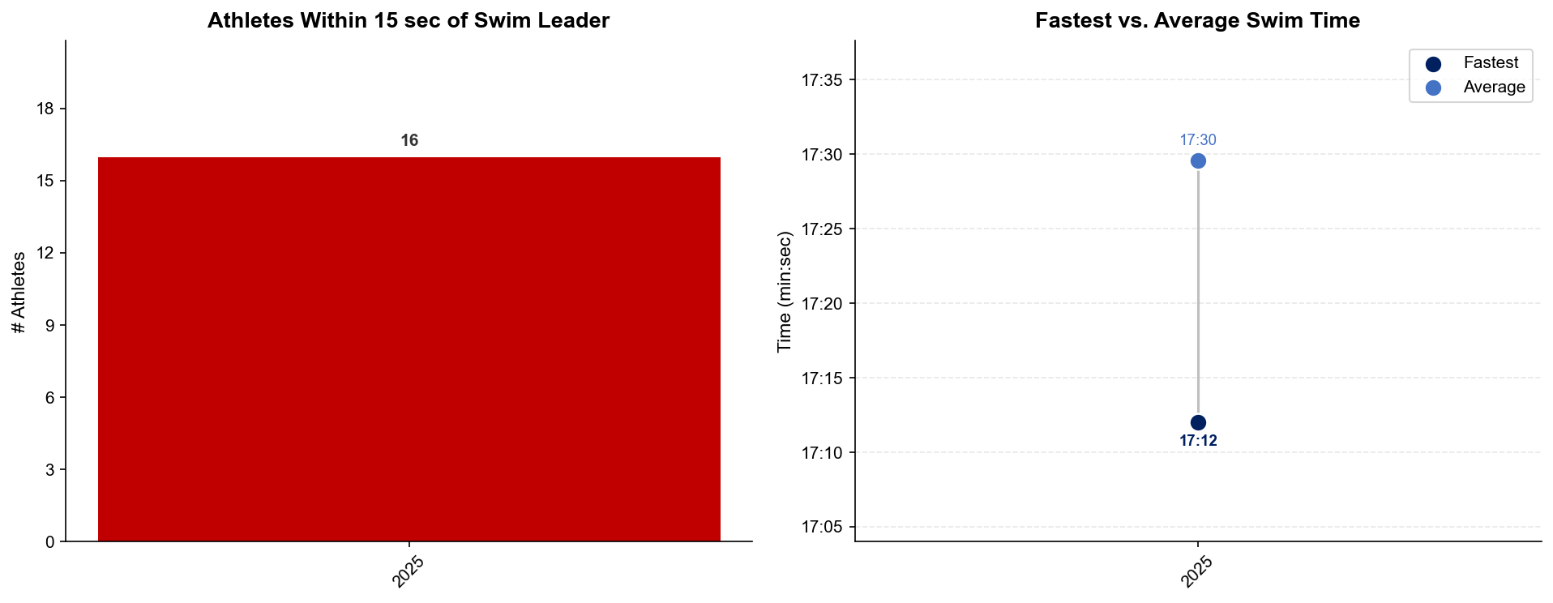
Swim Exit Dynamics — Elite Men
Alghero

Slide 9
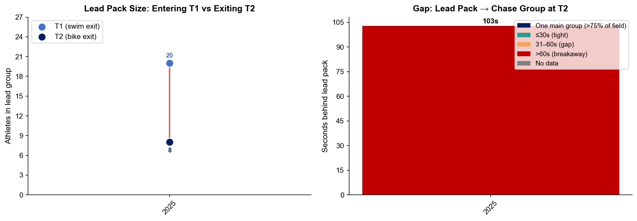
Bike Pack Evolution — Elite Men
Alghero
Lead pack = athletes within 15 sec of leader. T1 = lead group entering the bike; T2 = lead group exiting the bike.
Year | Lead Size @ T1 | Lead Size @ T2 | Change | Chase Group @ T2 | Chase Gap*
2025 | 20 | 8 | -12 | 24 | 103s
Lead pack = athletes within 15 sec of leader. Chase group = athletes within 15 sec of the first athlete outside the lead pack. * Chase Gap = seconds from the last lead-pack athlete to the first chase-group athlete at T2.
Dropouts: 2025: 10 DNF/LAP (4 in lead group at bike, t1)

Slide 10
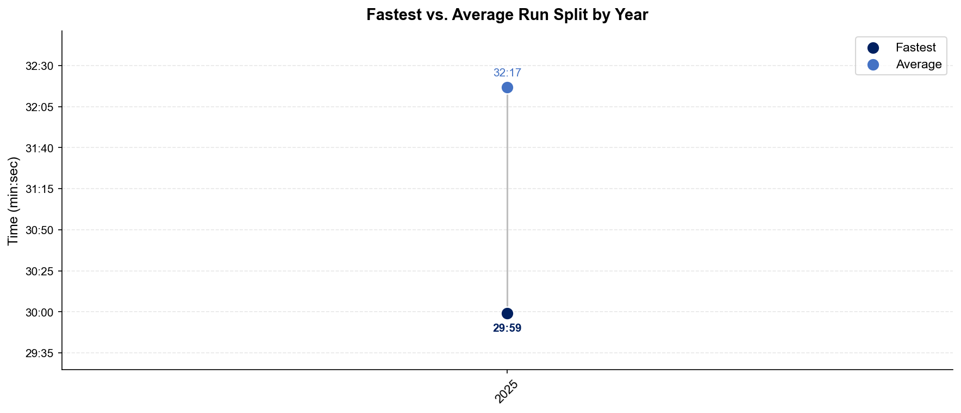
Run Split Analysis — Elite Men
Alghero

Slide 11
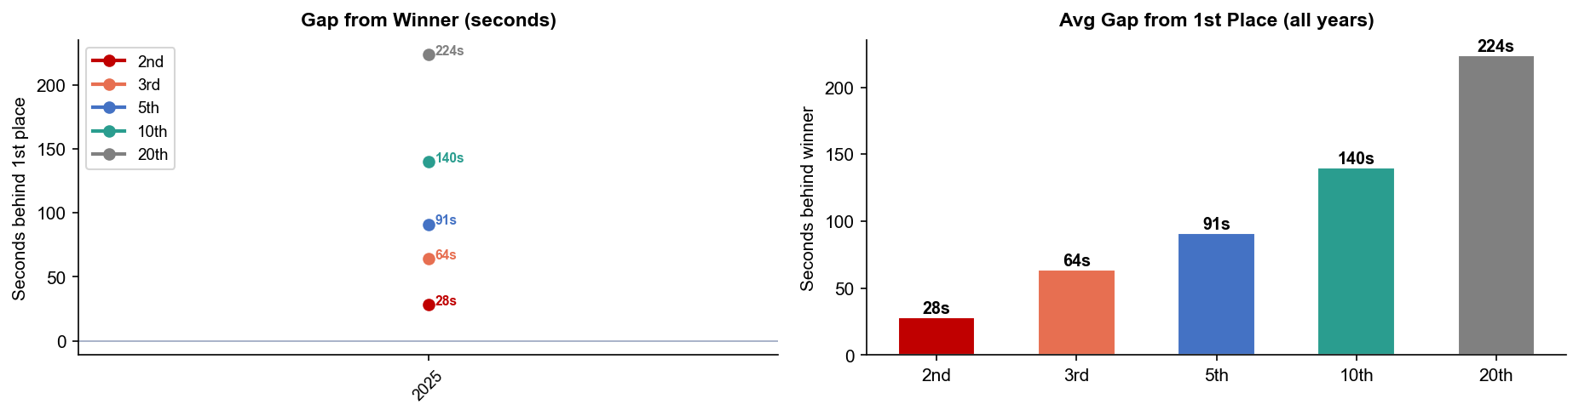
Key Position Times — Elite Men
Alghero
Year | 1st | 2nd | 3rd | 5th | 10th | 20th
2025 | 1:44:05 | 1:44:33 +28s | 1:45:09 +64s | 1:45:36 +91s | 1:46:25 +140s | 1:47:49 +224s

Slide 12
Race Conditions — Elite Men
Alghero
Year | Date | Air Temp | Humidity | Wind (km/h) | Precip (mm) | Water Temp | Wetsuit | Conditions
2025 | May 31 | 27 | 72% | 9 | 0.0 | 22 | forbidden | —
Air temp, humidity, wind, and precipitation sourced from Open-Meteo historical archive (race window 08:00–11:00 local) where WT API data is absent. Values marked * are Open-Meteo estimates. Water temp and wetsuit ruling are from the World Triathlon API per program.

Slide 13
ELITE WOMEN

Slide 14
Race Overview — Elite Women
Alghero
RACE HISTORY AT ALGHERO
3 KEYS TO SUCCESS
The Elite Women race at Alghero has been held 1 time in this analysis window (2025–2025). The event is staged as part of the World Championship Series calendar. [PLACEHOLDER: Add 1–2 sentences on notable storylines, competitive history, or what makes this event significant for Elite Women athletes. E.g. defending champions, record performances, dramatic finishes.]
1
Fast swimming is decisive — only ~7 athletes typically leave the water together. A strong swim directly builds a race-winning gap before T1.
2
[PLACEHOLDER: Key 2 — Describe bike strategy: is this a pack race or do breakaways form? What power/tactics are needed to stay in the lead group?]
3
Run speed separates the podium — the fastest run pace averages ~3:25/km with a ~141s spread between fastest and average finisher. Either a pre-built lead from the bike or exceptional run speed is required to win.

Slide 15
Results Summary — Elite Women
Alghero
Year | Date | Category | Field | Winner | Winner Time | Air Temp | Water Temp | Swim km | Bike km | Run km
2025 | May 31 | World Championship Series | 32 (7 DNF/LAP/DNS) | Beaugrand | 1:55:55 | 28 | 21.8 | 1.50 | 40.5 | 10.0

Slide 16
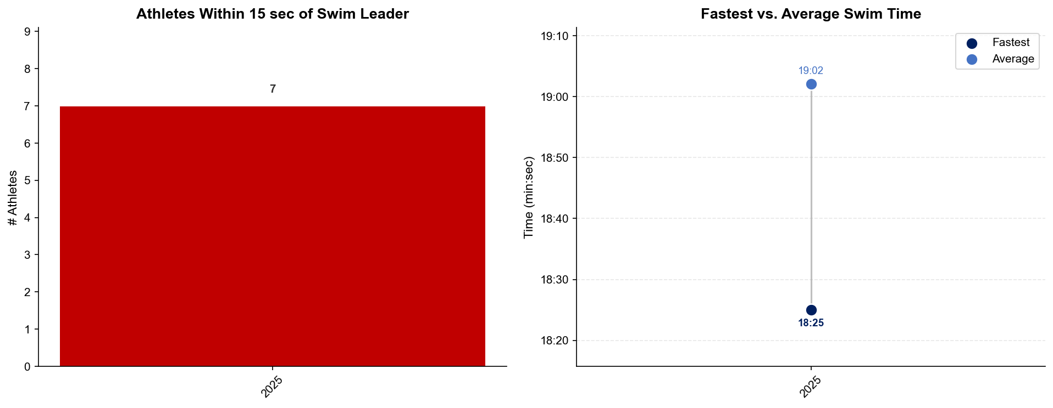
Swim Exit Dynamics — Elite Women
Alghero

Slide 17
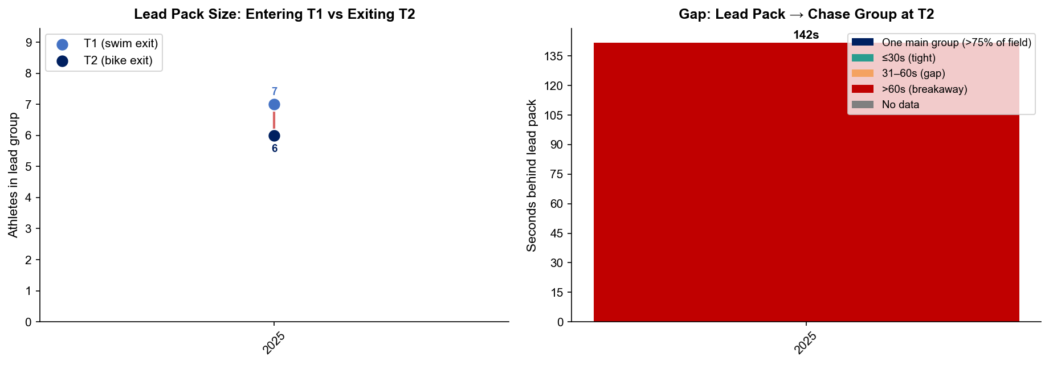
Bike Pack Evolution — Elite Women
Alghero
Lead pack = athletes within 15 sec of leader. T1 = lead group entering the bike; T2 = lead group exiting the bike.
Year | Lead Size @ T1 | Lead Size @ T2 | Change | Chase Group @ T2 | Chase Gap*
2025 | 7 | 6 | -1 | 21 | 142s
Lead pack = athletes within 15 sec of leader. Chase group = athletes within 15 sec of the first athlete outside the lead pack. * Chase Gap = seconds from the last lead-pack athlete to the first chase-group athlete at T2.
Dropouts: 2025: 7 DNF/LAP

Slide 18
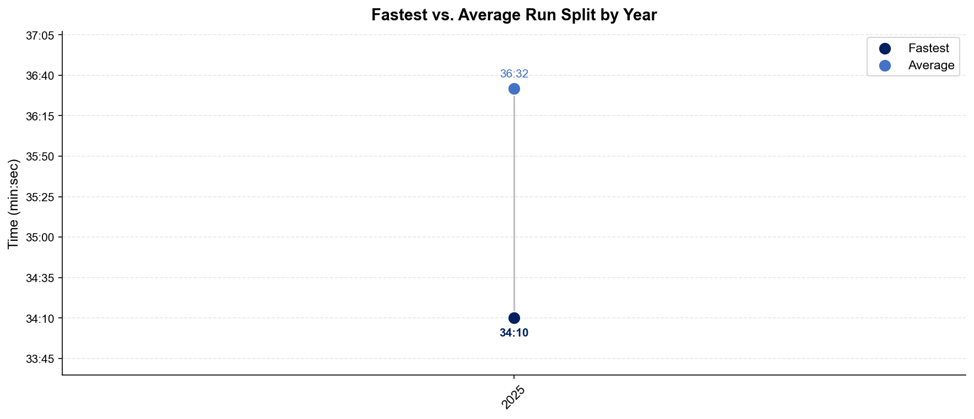
Run Split Analysis — Elite Women
Alghero

Slide 19
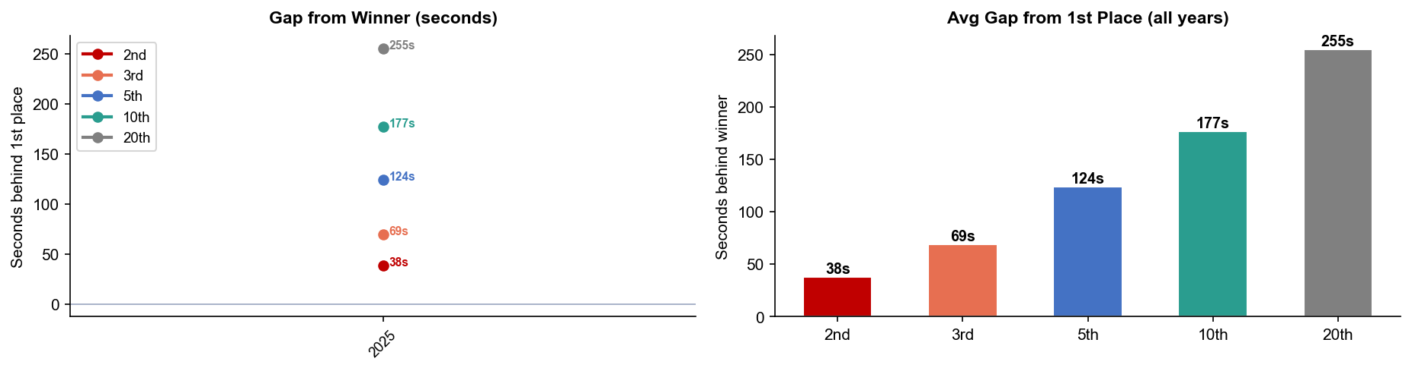
Key Position Times — Elite Women
Alghero
Year | 1st | 2nd | 3rd | 5th | 10th | 20th
2025 | 1:55:55 | 1:56:33 +38s | 1:57:04 +69s | 1:57:59 +124s | 1:58:52 +177s | 2:00:10 +255s

Slide 20
Race Conditions — Elite Women
Alghero
Year | Date | Air Temp | Humidity | Wind (km/h) | Precip (mm) | Water Temp | Wetsuit | Conditions
2025 | May 31 | 28 | 72% | 9 | 0.0 | 21.8 | forbidden | —
Air temp, humidity, wind, and precipitation sourced from Open-Meteo historical archive (race window 08:00–11:00 local) where WT API data is absent. Values marked * are Open-Meteo estimates. Water temp and wetsuit ruling are from the World Triathlon API per program.

